Slide 1
SDM COLLEGE OF ENGINEERING AND TECHNOLOGY,
Dharwad-580002
(An autonomous Institution affiliated to
Visvesvaraya Technological University, Belagavi – 590018)
Department of Computer Science and Engineering
Major Project Phase-2 on
“Traffic Signs Recognition”
Proposed by
Anirudh Gudisagar USN:2SD20CS016
Bharatesh Nagaraj Labhagond USN:2SD20CS031
Rajesh Pawar USN:2SD20CS083
Sharanabasava USN:2SD20CS098
Students of 8th Semester CSE Department
Division: B
Under the guidance of
Prof. Sharada H N
Department of CSE , SDMCET, Dharwad-02.
Academic Year 2023-2024

Slide 2
Introduction
Traffic signs classification is a problem one is going to inevitably face in many real world applications, such as self-driving car algorithms, driving assistance software or even road maintenance.
Self-driving cars need traffic sign recognition in order to properly parse and understand the roadway.
System of automatically recognizing the traffic signs motivates to build “smarter cars i.e Self driving cars”.

Slide 3
Problem Statement
Developing a real-time traffic sign detection and recognition system using Neural Networks to enhance driving safety and comfort, supporting drivers and autonomous vehicles alike.

Slide 4
Objectives
To analyse existing Traffic Sign Recognition systems.
To detect and recognize traffic signs in real-time.
To build a higher robust and faster model to provide the necessary accuracy in recognition of traffic signs.

Slide 5
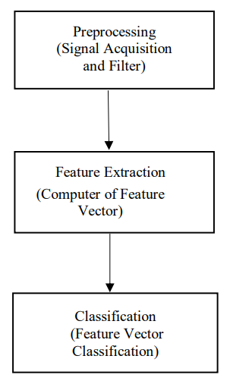
Image Pre-Processing Strategy

Slide 6
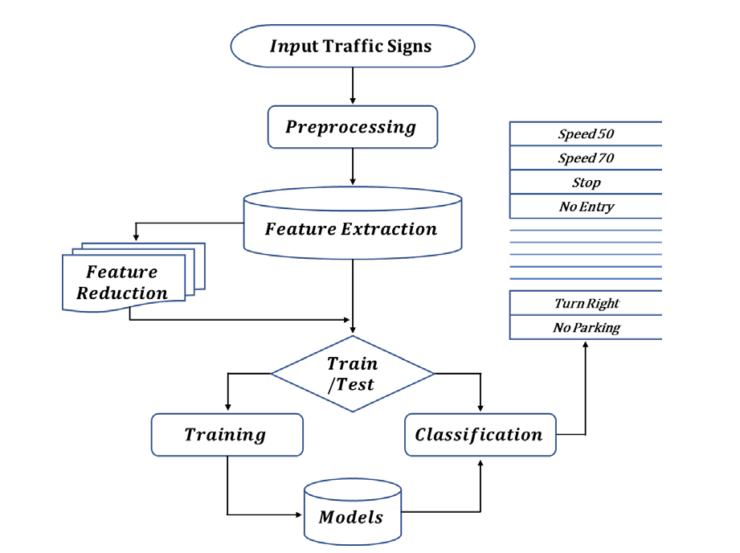
System Design

Slide 7
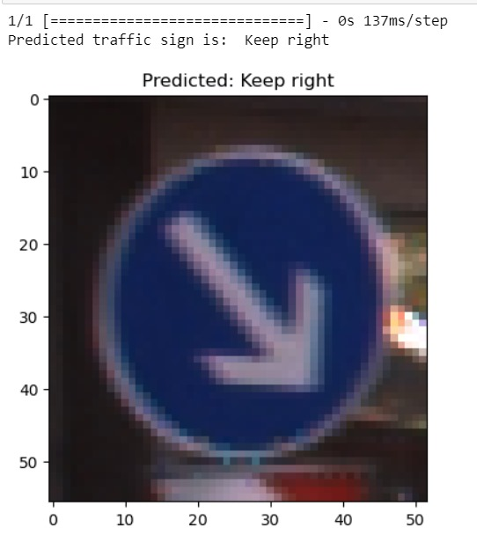
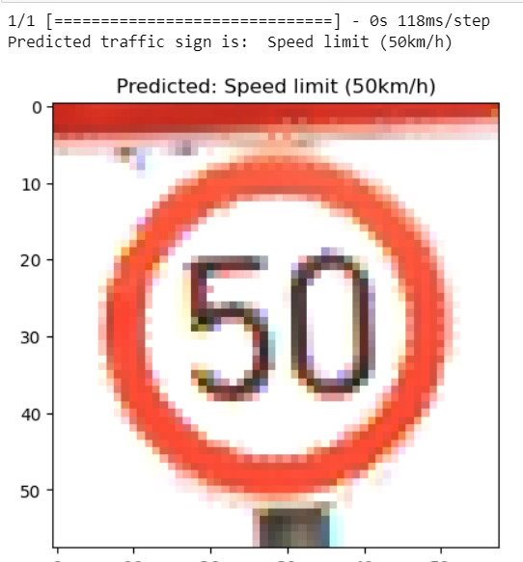
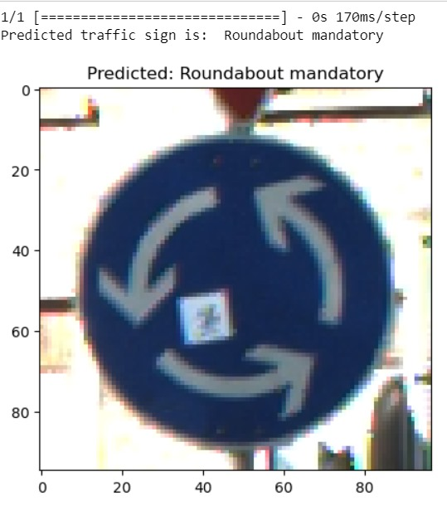
Phase-1 Results:

Slide 8
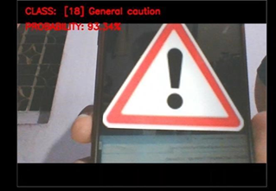
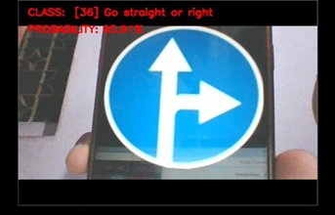
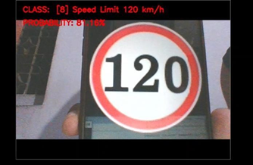
Phase-2 Results:

Slide 9
Conclusion
The proposed automatic traffic sign detection and recognition system integrates advanced techniques, primarily convolutional neural networks (CNNs), to enhance driving safety and comfort.
Through this project, the aim is to mitigate road accidents by alerting drivers about upcoming traffic signs.

Slide 10
References
Auranuch Lorskul and Jackrit Suthalkorn, “Traffic Sign Recognition Using Neural Network on OpenCV: Towards Intelligent Vehicle/Driver Assistance System”,2017.
Citali Gamez Serma and Yassine Ruichek, Senior member, IEEE, “Traffic Signs Detection and Classification for European Urban Environments”.
Abdul Mannan, Kashif Javed, Atta Ur Rehman, Haroon A.Babri, and Serosh Noon. “Classification of Degraded Traffic Signs Using Flexible Mixture Model and Transfer Learning”.

Slide 11
Annexure
Published paper in Journal of Emerging Technologies and Innovative Research.
Paper Link

Slide 12
Thank You!

